Slide 1

etcd, What’s next for cluster management?
Gyuho Lee leegyuho@amazon.com

Slide 2

Agenda
Challenges in etcd cluster management
Can we do better? Yes!

Slide 3
etcd is distributed
Distributed (typically 3 or 5 nodes)
Consistent + Partition Tolerant + (Highly) Available, in CAP theorem
Strong(Sequential) Consistency (NOT eventual consistency)
Consensus over Raft

Slide 4
Challenge #1
etcd Membership Reconfiguration

Slide 5
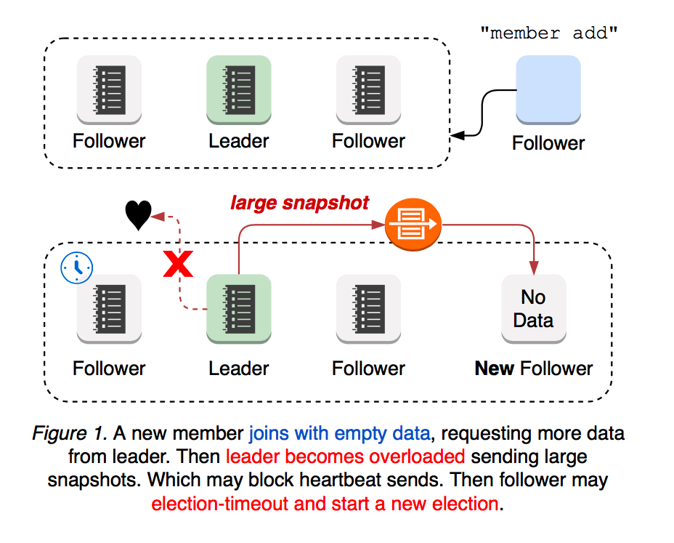
Disruptive membership reconfiguration
Cluster with new member is more vulnerable to leadership election

Slide 6
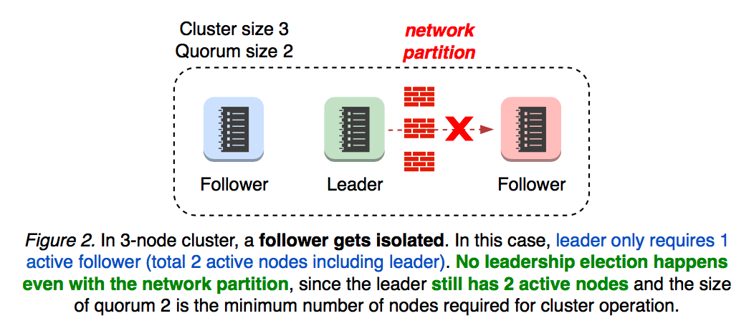
Network Partition Will Happen!
Quorum size = (cluster size / 2) + 1
Leadership election WILL NOT happen!

Slide 7
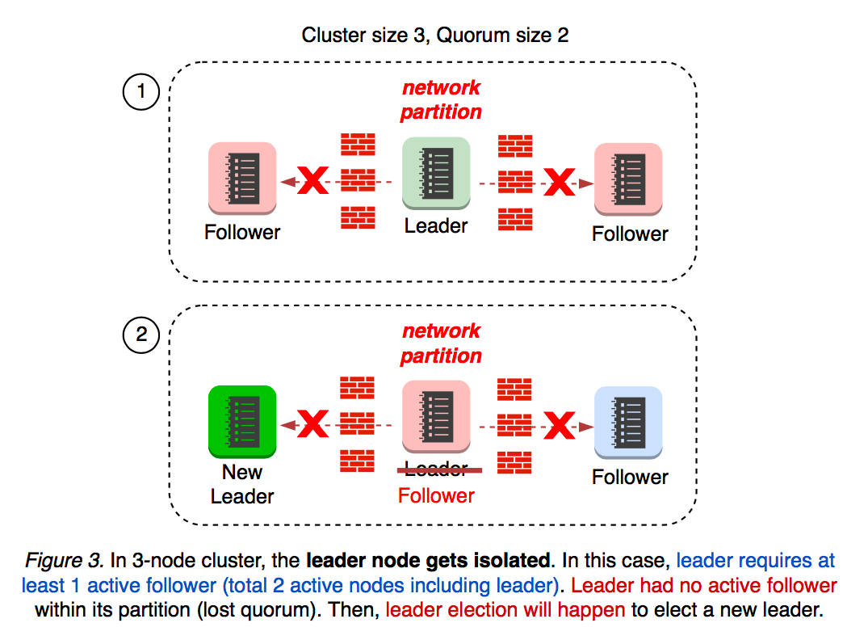
Network Partition Will Happen!
What if leader gets isolated?
Leadership election WILL happen!

Slide 8
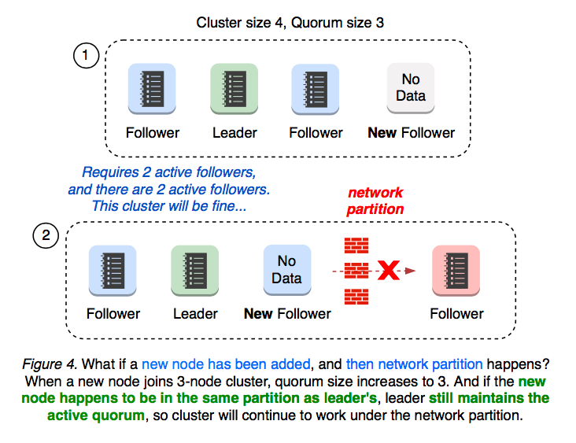
Network Partition + Membership Reconfiguration
This is OK

Slide 9
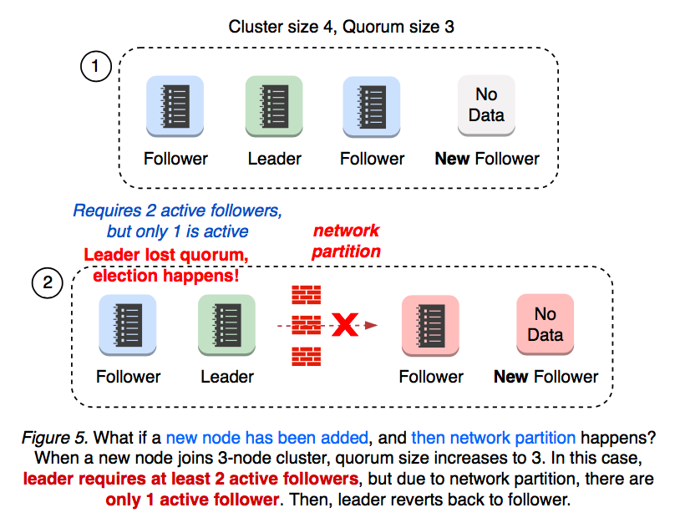
Network Partition + Membership Reconfiguration
This is NOT OK

Slide 10
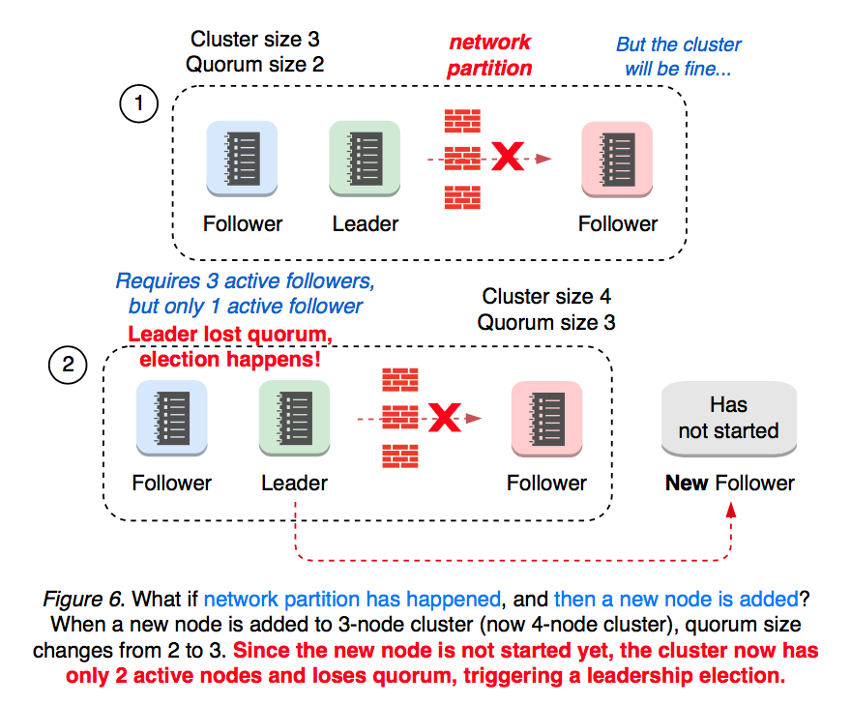
Network Partition + Membership Reconfiguration
This is NOT OK

Slide 11
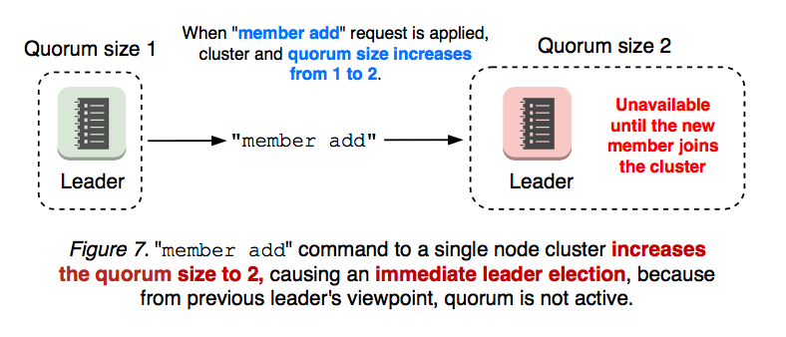
Disruptive membership reconfiguration
Quorum size = (cluster size / 2) + 1
Member add operation is 2-step process

Slide 12
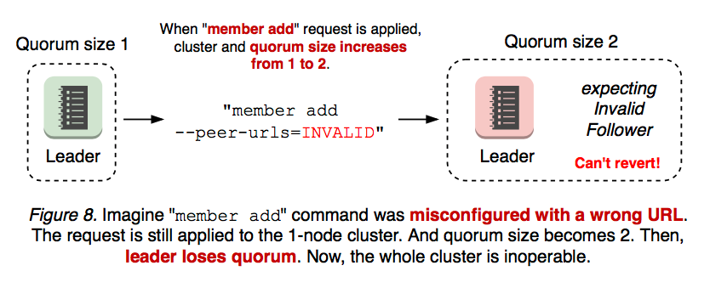
Disruptive membership reconfiguration
Quorum size = (cluster size / 2) + 1
Member add operation can increase the quorum size

Slide 13
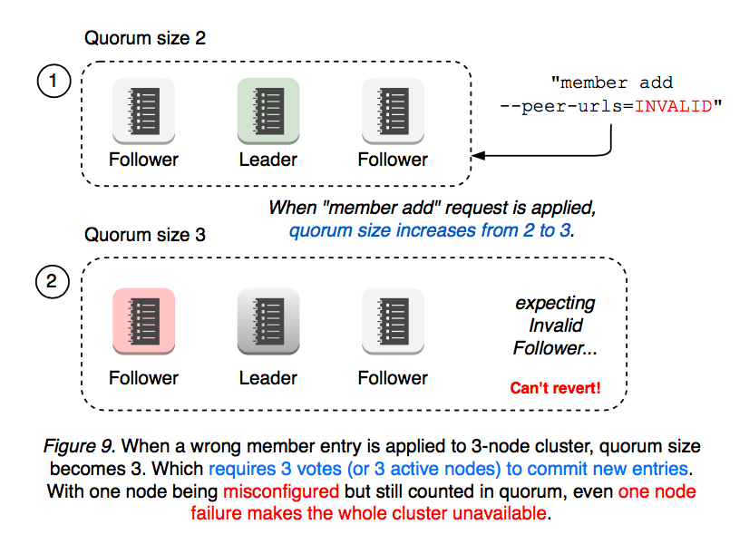
Disruptive membership reconfiguration
Quorum size = (cluster size / 2) + 1

Slide 14
Introducing etcd Raft Learner

Slide 15
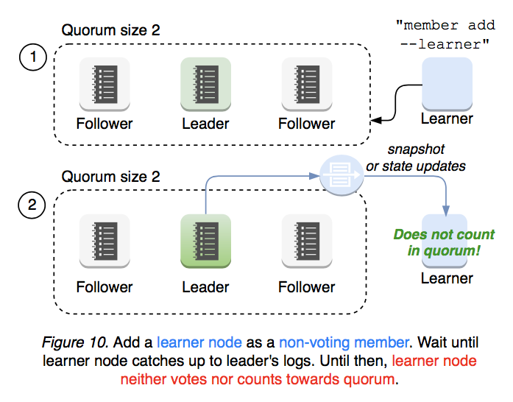
Raft Learner (etcd v3.4, 2019)
Learner joins as a non-voting member, does not count in quorum

Slide 16
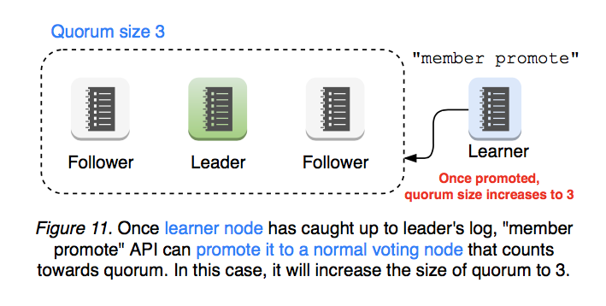
Raft Learner (etcd v3.4, 2019)
Learner joins as a non-voting member, does not count in quorum

Slide 17
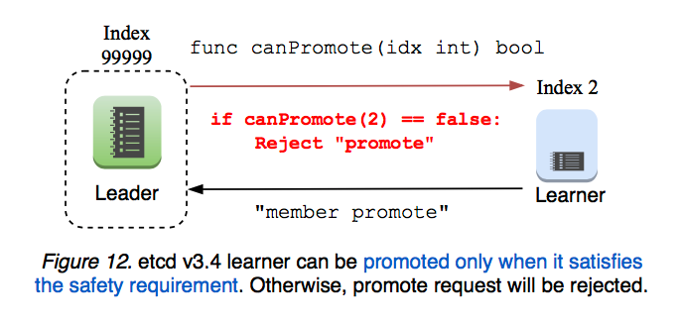
Raft Learner (etcd v3.4, 2019)
etcd server will validate "promote" request

Slide 18
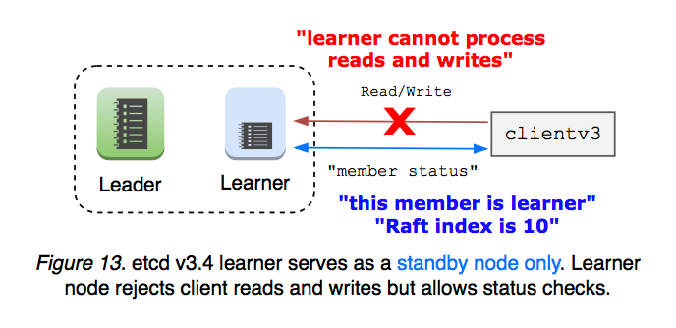
Raft Learner (etcd v3.4, 2019)
Learner rejects all reads and writes (for simplest implementation possible)

Slide 19
Challenge #3
etcd Upgrade

Slide 20
How does etcd upgrade work?
1. Leader fetches server versions from each peer
2. Leader picks the lowest version as cluster version
3. Leader broadcasts it to peers
4. Each peer tries to apply that cluster version
5. Fail if requested cluster version is downgrade
Upgrade must happen incrementally, one by one (rolling upgrade)

Slide 21
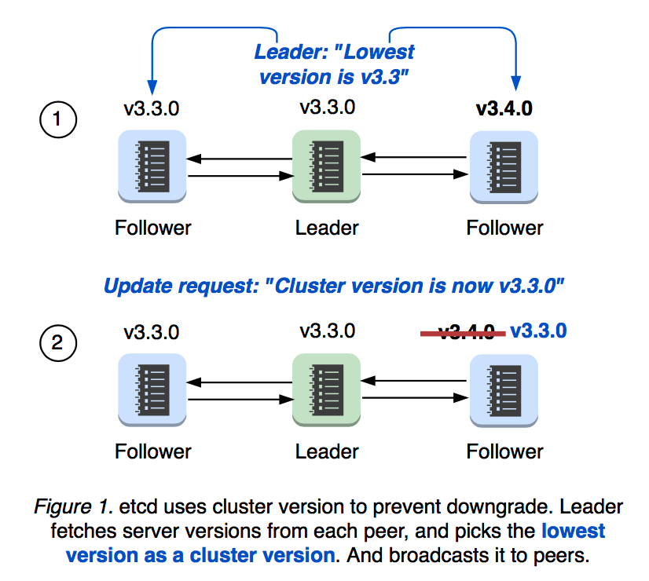
etcd maintains cluster version

Slide 22
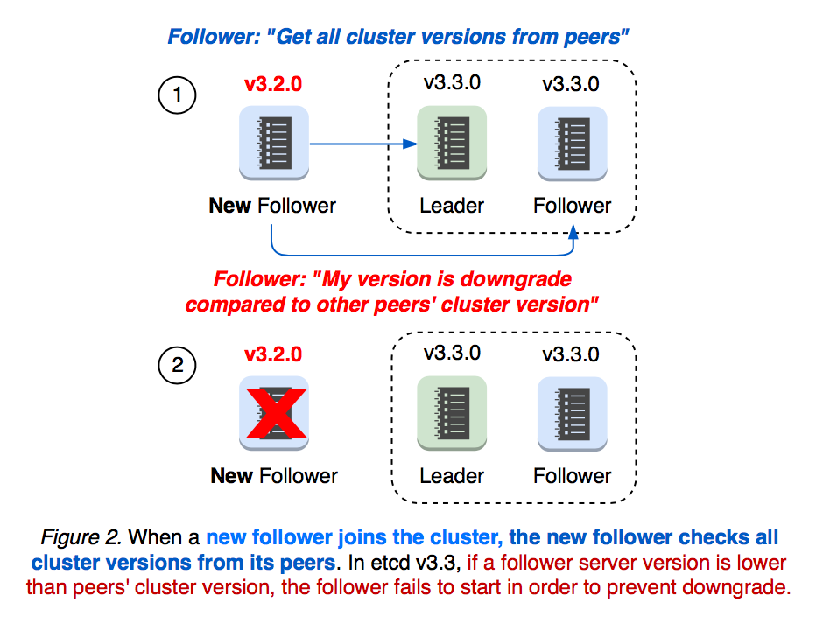
etcd maintains cluster version

Slide 23
Introducing etcd Server Downgrade

Slide 24
Downgrade (etcd v3.4, 2019)
(Similar to etcd rolling upgrade)
"downgrade" command to temporarily whitelist a lower version:
etcdctl downgrade --target-version [TARGET_VERSION]
etcdctl downgrade status
etcdctl downgrade cancel
See github.com/etcd-io/etcd/issues/9306 for more detail.
(Credits to github.com/wenjiaswe at Google)

Slide 25
Thank You!

